Slide 1

Team Details
Team name: Oblivion
Team leader name: Abhishek Jha
Problem Statement: Open Innovation

Slide 2

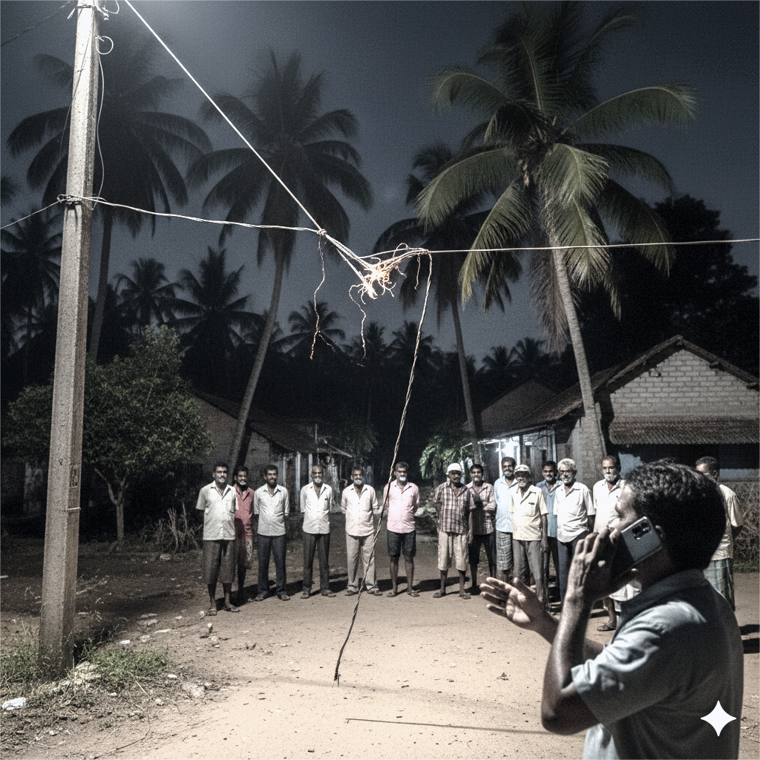
Problem & Its Solution
Since 2017, over 100+ lives lost due to faulty LT lines in Kerala. Villagers live in fear every rainy season.
Current circuit breakers are non-smart, leaving villages unsafe and powerless.
In rural India, Current manual fault detection can take hours, turning small faults into deadly hazards.
Aging infrastructure, with weakened poles, increases the risk of failure.
Problem:
Power cuts in rural areas stop water pumps, medical equipment and essential services.
Manual fault detection takes hours, risking lives.
Proposed Solution:
Software that detect LT line breakage and Isolate it.
We need hardware for detection.
The hardware will send details of every pole where it is implemented to the software.
Then if fault detected, the software will automatically isolate the faulty section, with the help of existing distribution switchgear or breakers that utilities already have.
Cloud dashboard provides alerts for maintenance that will reduce the downtime.
Main benefits:
Location identification: Gives the information about point/area where the fault has occured to utilities.
Detects fallen or broken LT lines and isolates it to prevent electrocution.
Predictive Maintenance: Continuous data logging allows utilities to spot weak lines, reducing outages and repair trips.
Works with existing infrastructure.

Slide 3
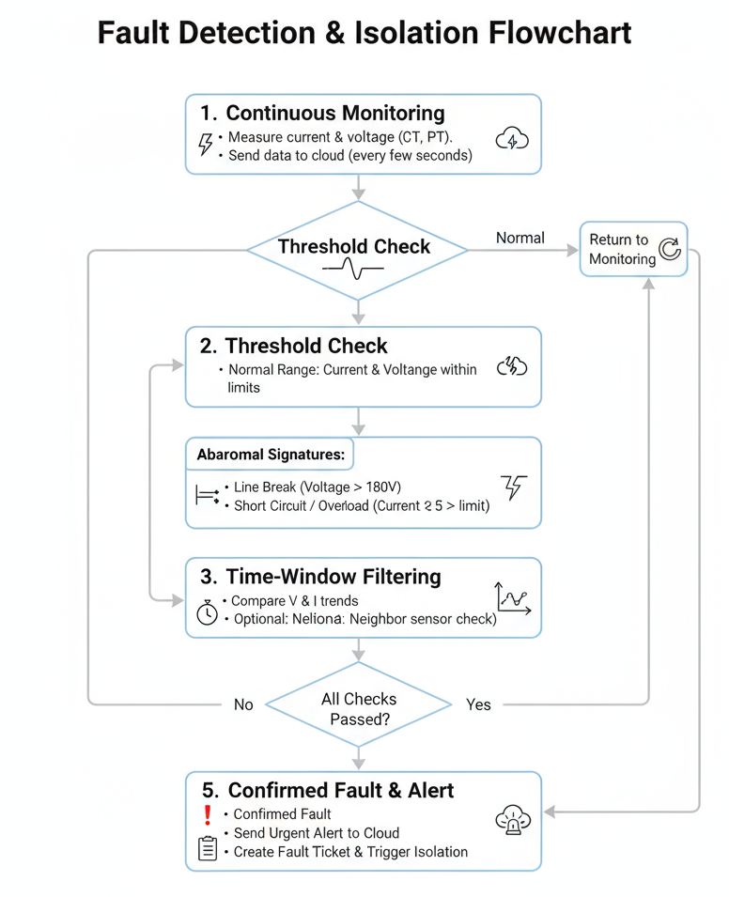
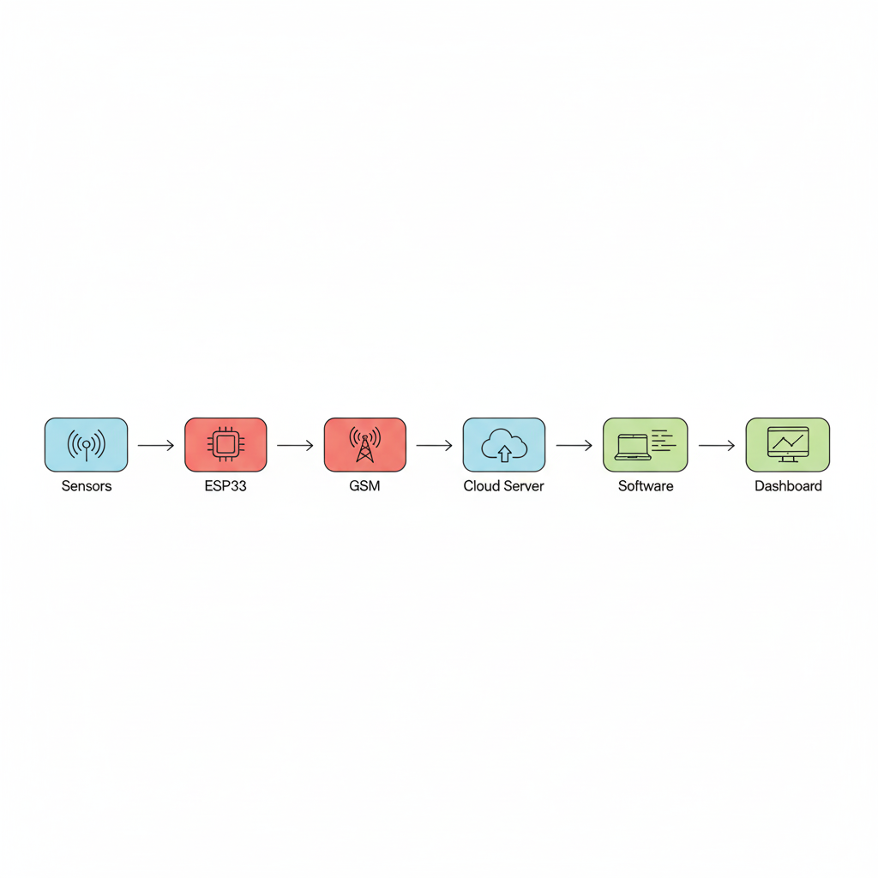
Process flow & Architecture
Fault detection & Isolation:
System Overview:
Hardware: Microcontroller + CT/PT sensors + GSM
GSM module sends the data in JSON packets like:
{
"pole_id": "P123",
"current": 2.5,
"voltage": 230,
"timestamp": "2025-09-22T12:30:00"
}
Software: The system is built with Node.js backend, React.js frontend, MongoDB database, and AWS cloud for scalable processing and twilio for alerts. It will already have internet access to collect the signals.
1. Continuous Monitoring
Multiple Checks
Sensors
Micro
controller
GSM
Cloud Server
Software
Dashboard
2. Threshold Check
Hardware needed
Distribution switchgear
Abnormal Signature
3. Time Window Filtering
4. All checks passed?
5. Confirmed Fault & Alert

Slide 4





Google Technologies Powering Our Solution
Our rural LT fault detection system leverages a suite of robust Google technologies to ensure reliability, scalability &
security.
Google Firebase
Google Maps Platform
Firebase Realtime Database: Stores live LT fault data
Maps SDK: Shows fault location on live map
Cloud Functions: Triggers automatic fault alerts
Geocoding API: Converts pole GPS to readable location
Firebase Authentication: Secures staff login
Google Cloud Platform (GCP)
Google Communication APIs
Cloud Run: Hosts backend services
Firebase Cloud Messaging: Sends instant fault alerts
to staff
Cloud Storage: Stores fault logs and reports
Cloud Logging: Tracks system maintenance history
These technologies together form the Google-powered backbone of our rural LT fault detection system.

Slide 5


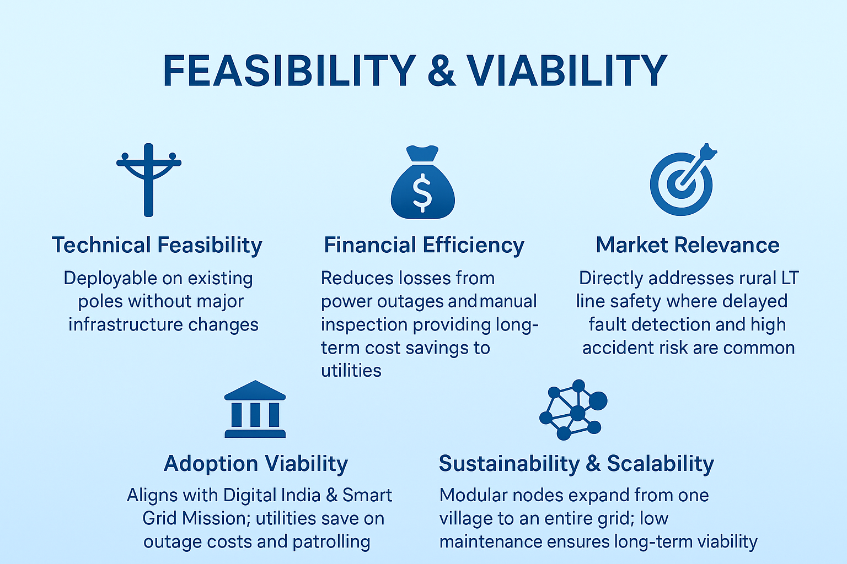
Additional details
Feasibility Analysis:
Challenges & Solutions:
1. Significant initial investment that could be costlier for villages.
Solution: We are not applying the hardware on each pole. Instead we are applying on sufficient distant poles and junction poles that lowers the initial cost.
2. Sensor noise, transient current drops, or communication glitches can generate false line-break alerts.
Solution: Filtering false signals in software by analyzing current and voltage as parameters.
Technical Feasibility
Financial Efficiency
Market Relevance
Adoption Viability
Sustainibility & Scalability
Future Scope & Improvements:
Use ML models on historical fault data to predict weak spots and forecast line failures before they occur (predictive maintenance).
Mobile App for Field Technicians: Provide real-time fault alerts to technicians, location to speed up on ground response.
Estimated Costing:
Software:
Initial Build: ₹4.5 – 5.5 Lakh
Year-1 Ops + Maintenance: ₹2.3 – 3.3L
Total (Build + 1 Year Ops): ~₹6.8 – 8.8L
Hardware: ₹1.9 – 2.9k of 1 unit
Labour cost: ₹1.5 – 2L (It will vary)

Slide 6
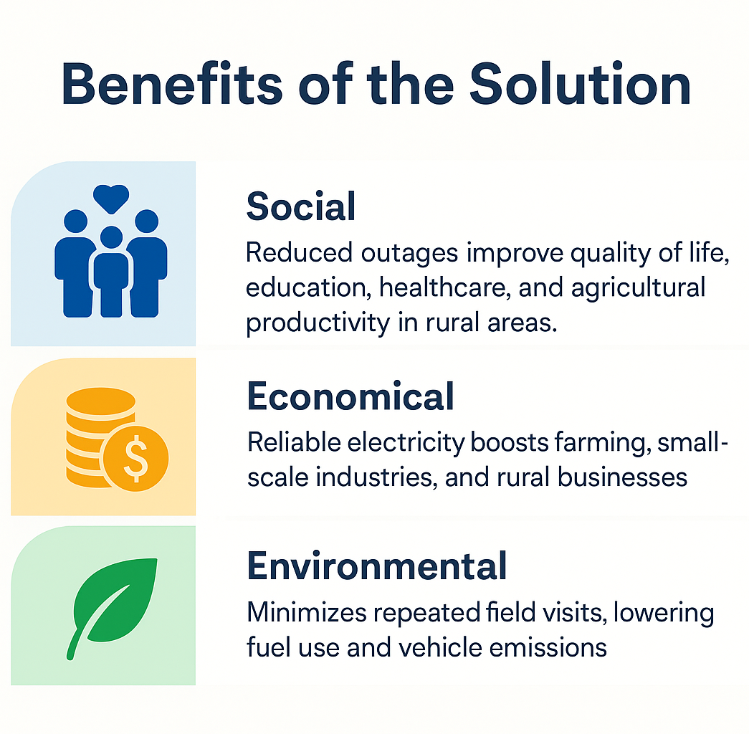
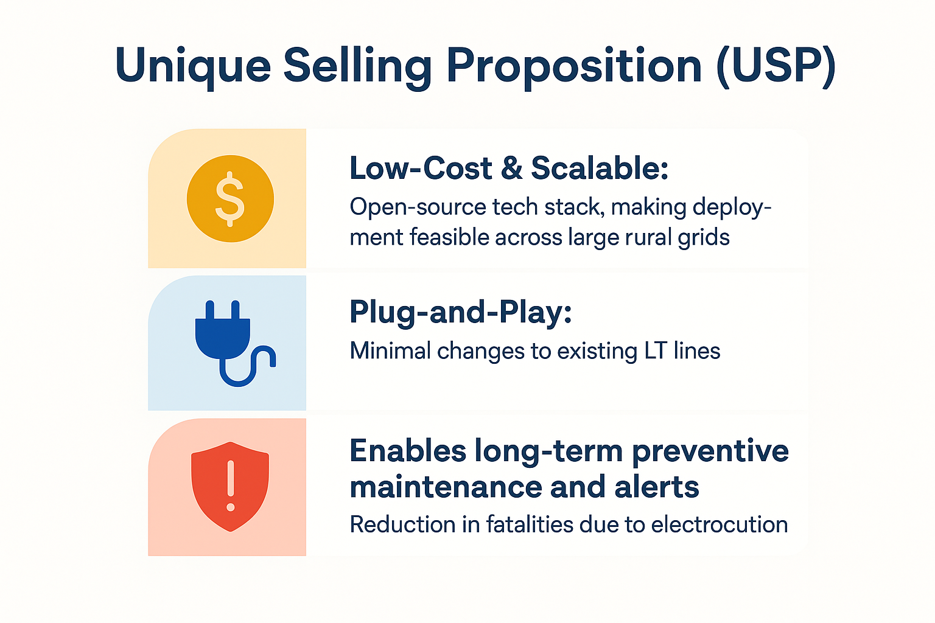
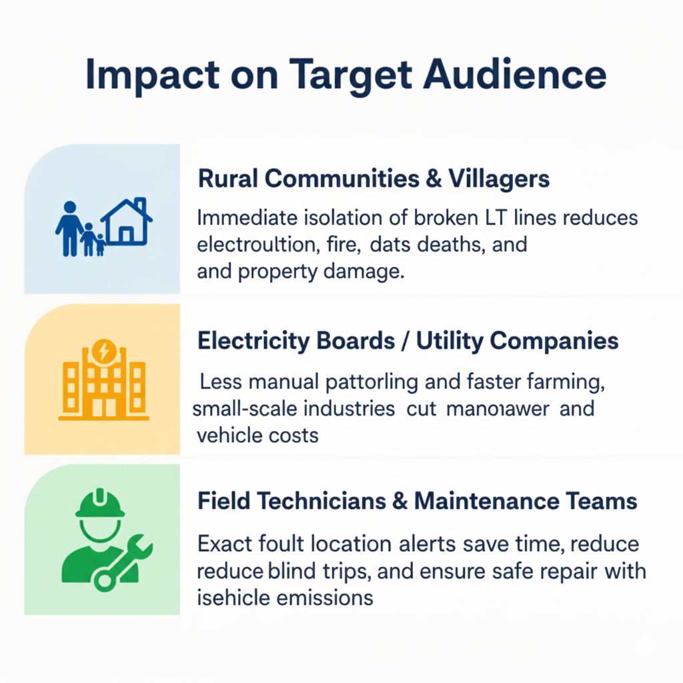
Impact & Benefits
Impact on Target Audience
Benefits of the Solution
Unique Selling Proposition (USP)
Rural Communities & Villagers
Social
Low cost & Scalable:
Immediate isolation of broken LT lines reduces electrocution, fire, deaths, and property damage.
Electricity boards / Utilities companies
Plug-and-Play:
Economical
Less manual patrolling and faster fault detection cut manpower and vehicle costs.
Field technicians & Maintenance teams
Enable long term preventive Maintenance & Alerts
Environmental
Exact fault location alerts save time, reduce blind trips, and ensure safe repair with isolation.
Revenue Streams:
1. Maintenance & Support Services: Ongoing income from periodic calibration, sensor replacement, and technical support contracts.
2. Data Insights & Predictive Analytics (Future): Utilities pay for advanced AI/ML predictive maintenance reports to plan grid upgrades and reduce breakdowns.
3. Partnerships with Government Schemes: Revenue through adoption under Digital India, NSGM, and Rural Electrification programs (subsidy + contracts).

Slide 7
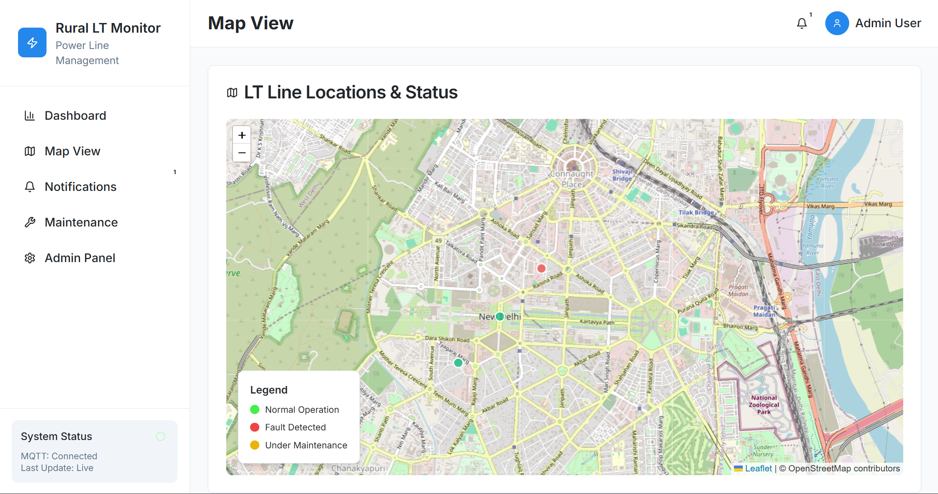
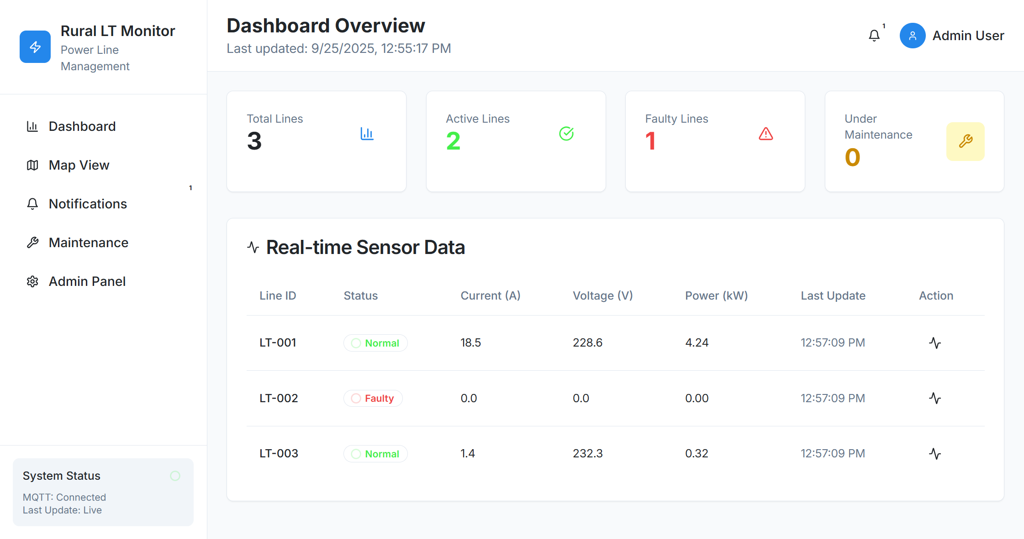
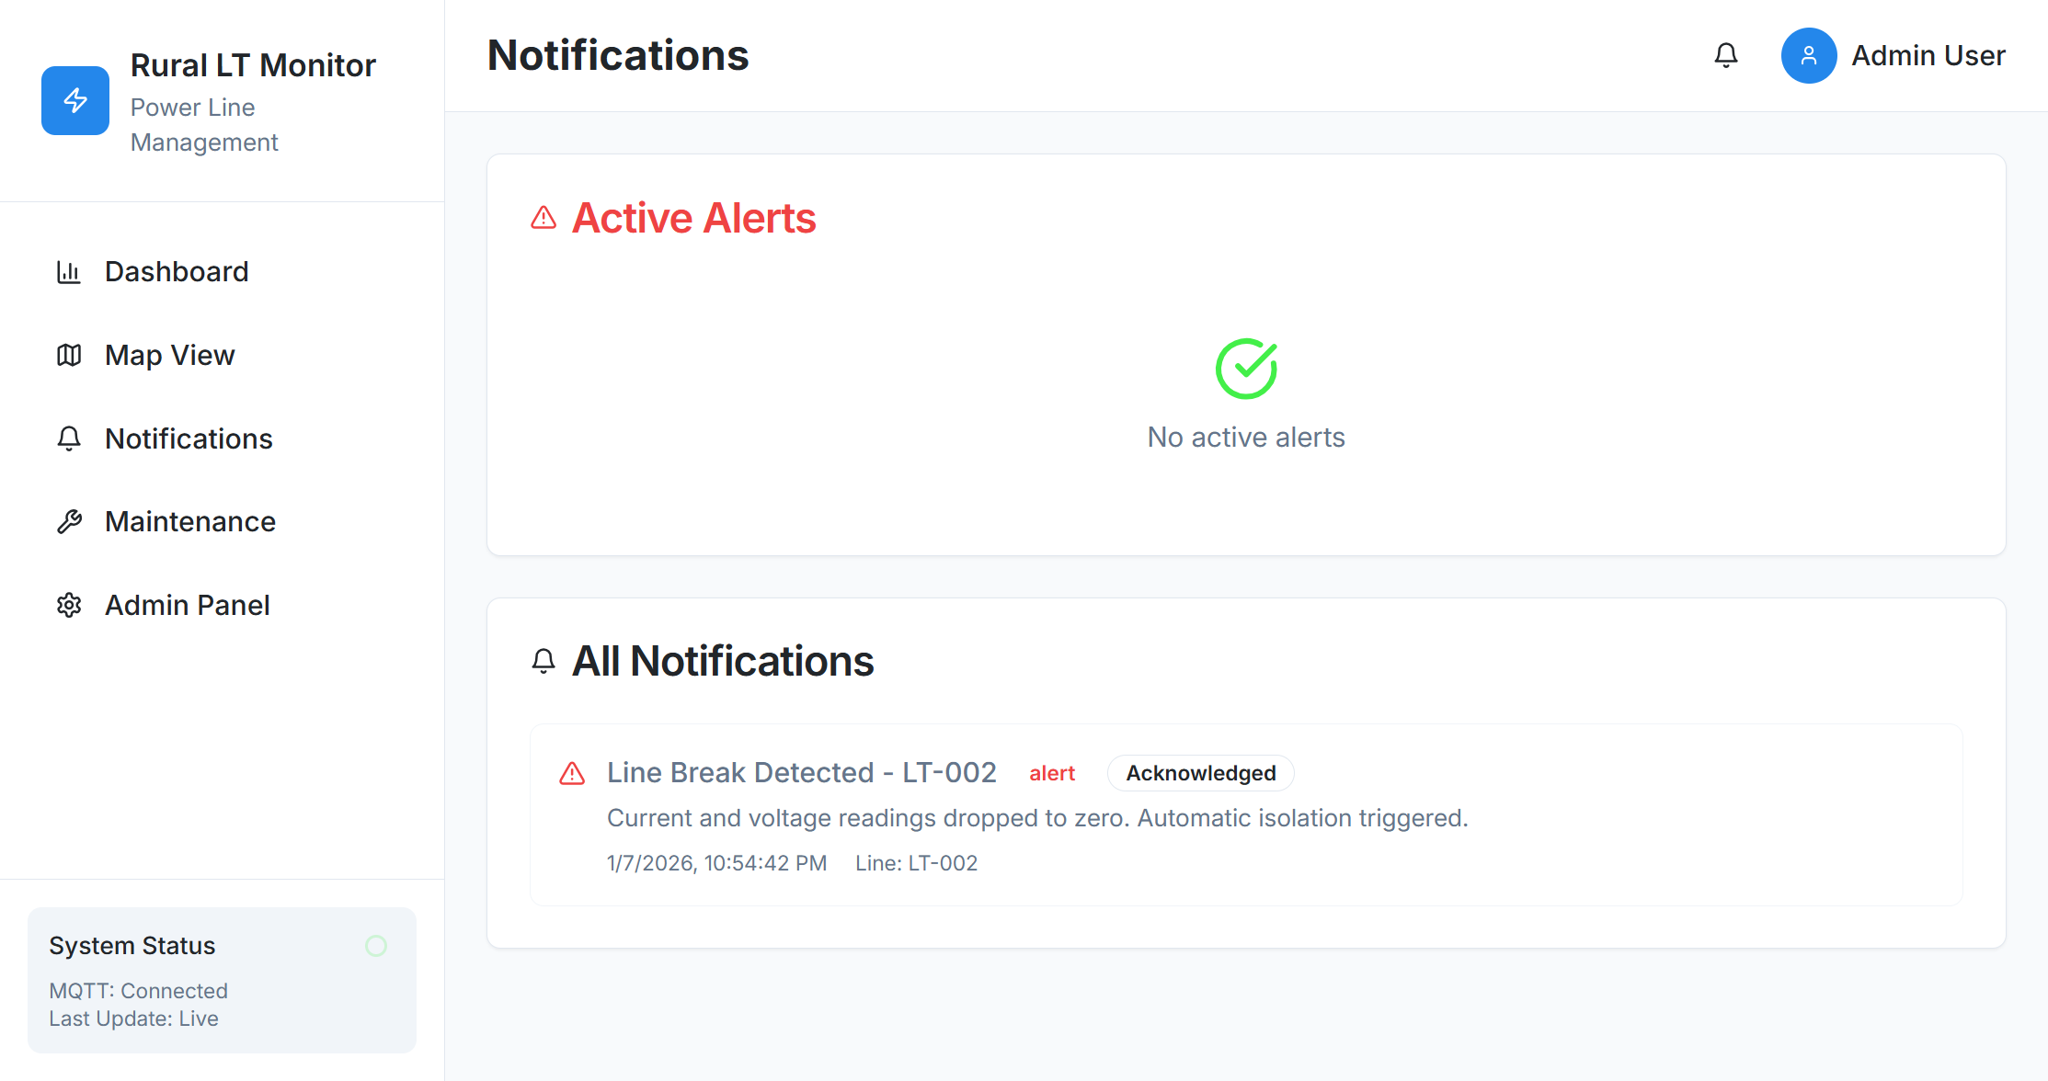
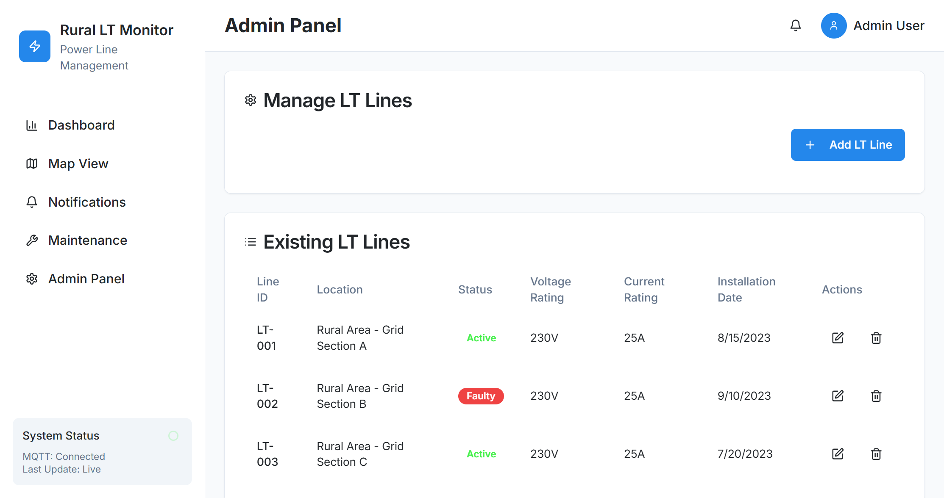
Snapshots of MVP

Slide 8




Provided Links
https://rural-grid-watch--yhkatal123.replit.app/
https://youtu.be/L2n4N4W-2oo?si=dce2myqRTCS4M3nP
https://github.com/yhkAtharv/lt-line-break-detection

Slide 9

Thank you!

